Slide 1


3 Phase Matrix Converter
Team 20: Bi-Weekly Update 1 Chase Barnes
Shanelle Algama
Daniel Loeza Sponsor: Dr. John Lusher TA: Mohamed Massaoudi
Notes:
Barnes

Slide 2
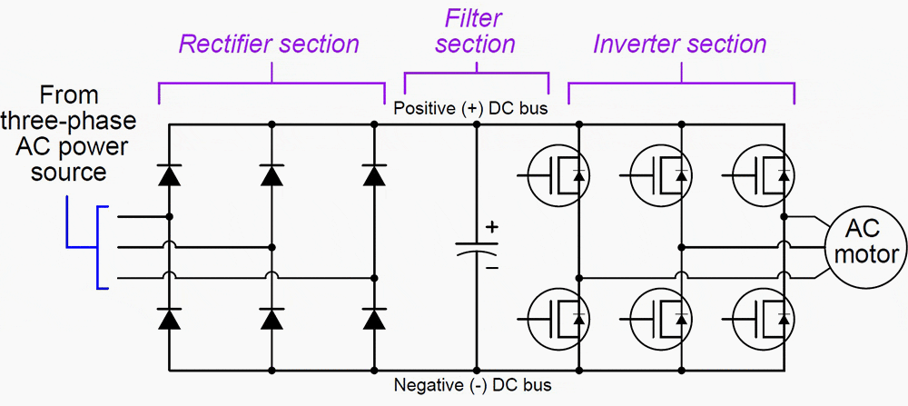
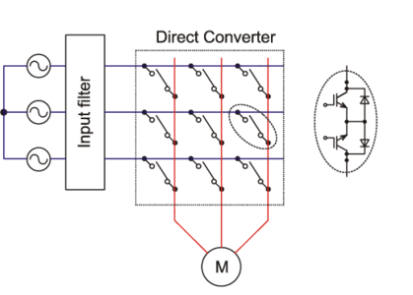
Project Summary
Traditional Variable Frequency Drives utilizes AC-DC-AC conversion:
Decreased efficiency across power output, and increased harmonic distortion.
3 Phase Matrix Converter utilizes AC-AC conversion:
Reduced efficiency loss across components.
Notes:
Barnes

Slide 3
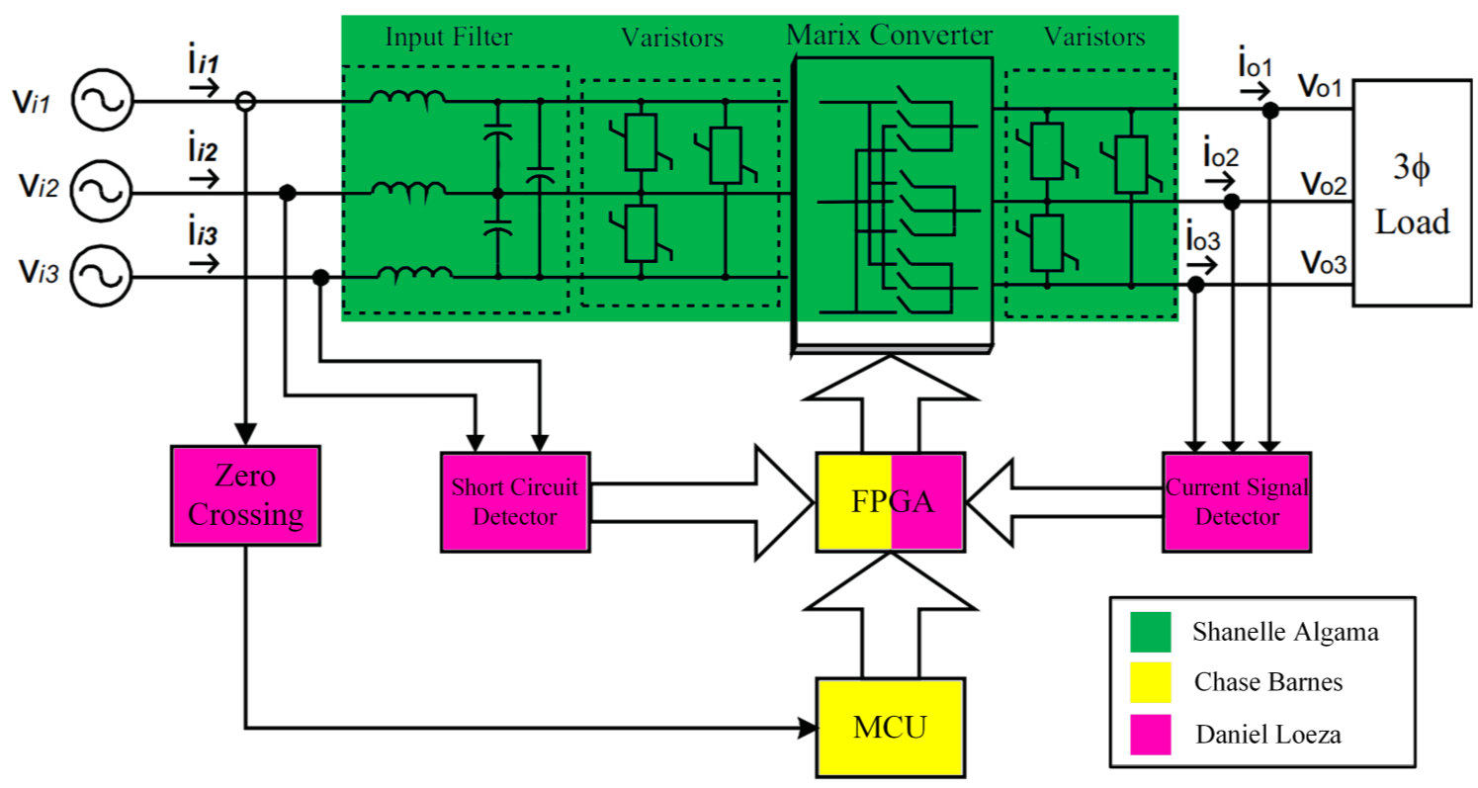
Project/Subsystem Overview
Bidirectional Switch subsystem
Creation of bidirectional switches with associated input filtration
Pulse Generator subsystem
Control board for sensing and communication to bidirectional switches
Firmware subsystem
Software for microcontroller, FPGA

Slide 4
Major Project Changes for 404
PSU DC Voltage change from 15V to 5V
Heat dissipation concerns
Change in component cost
Change in DC-DC converter
Large Heatsink addition

Slide 5
Project Timeline
September 23 - Pulse Generator will be assembled
September 30 - Firmware will be integrated with the Pulse Generator
September 30 - Full Matrix of Bidirectional Switches will be assembled
October 7 - Both the whole Pulse Generator and Matrix Converter Subsystems will be validated and functional
October 14 - System Integration will begin
October 21 - System Validation will begin
November 11 - System will be validated and functional
November 21 - Final Demo
Notes:
Eric

Slide 6
Firmware Subsystem
Chase Barnes
Accomplishments since 403 5 hrs of effort | Ongoing progress/problems and plans until the next presentation
FPGA Firmware Fully Functional MC Communication, Sensor Response Functional | MC Asynchronous Communication MC SVM Implementation Completion and Verification
Notes:
Barnes

Slide 7
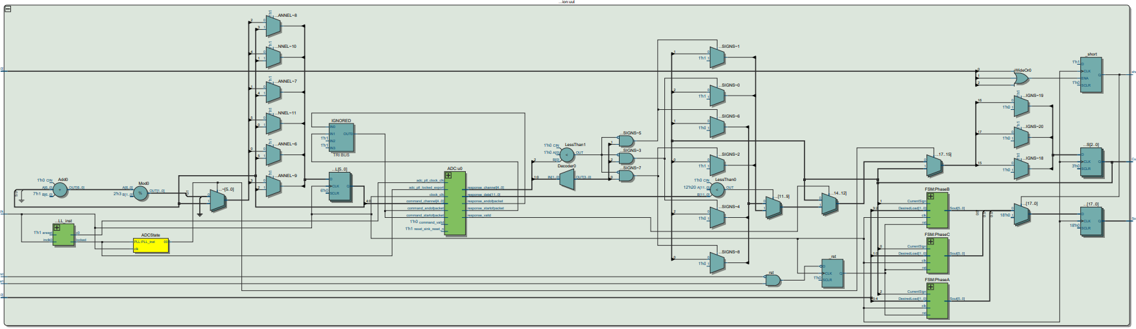
Firmware Subsystem
Chase Barnes
FPGA RTL With ADC and Shorting capabilities
Notes:
Barnes

Slide 8
Bidirectional Switch Subsystem
Shanelle Algama
Accomplishments since 403 5 hrs of effort | Ongoing progress/problems and plans until the next presentation
Single bidirectional switch board is functional in isolation. This was tested with the VARIAC (variable AC voltage input). New DC-DC Converter selected (previous one is discontinued due to sanctions) but it requires a different input voltage. | Power dissipation is a problem. Passive cooling will be tested to see if that mitigates the problem. Active cooling might be introduced later if passive is deemed insufficient. Redesign of PCB is currently underway. Improvements will be made with varistors, fuses, capacitors, more refined layout that will allow heatsinks to attach to IGBTs, connectors at edges, etc.

Slide 9
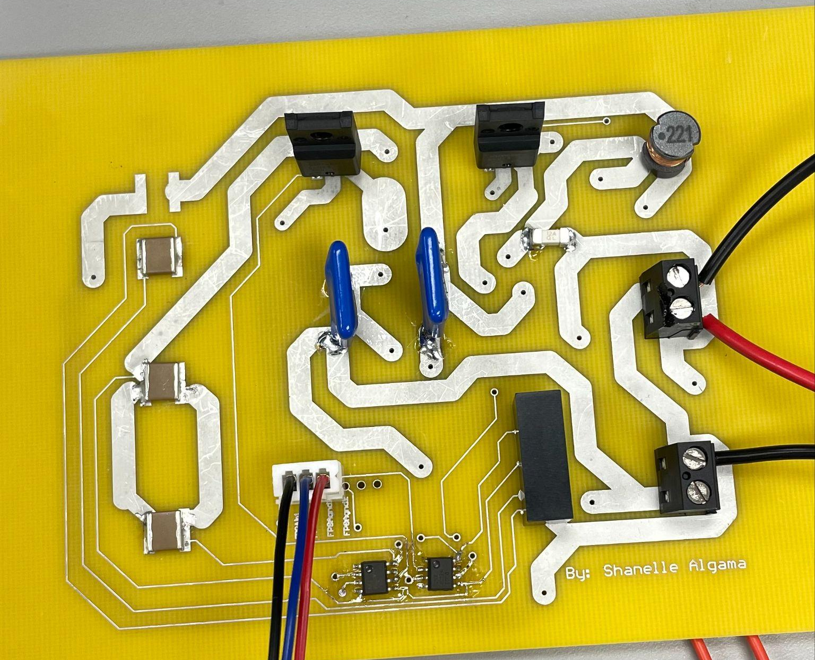
Bidirectional Switch Subsystem
Shanelle Algama
Add stitching vias, improve and optimize overall PCB design and properties, add component labels, and make changes to improve connections across a matrix of 9 individual boards.
Adjust placement of IGBTs to edge for heatsink application
Fix varistor setup
Adjust connectors to edge
Swap DC-DC converter
Swap SMD capacitors with through-hole capacitors

Slide 10
Pulse Generator Subsystem
Daniel Loeza
Accomplishments since 403 22 hours of effort | Ongoing progress/problems and plans until the next presentation
The board was redesigned to avoid the shorting issue from the initial design. FPGA output pins were redesigned to align with the input of the Bidirectional Switch. A new voltage regulator was selected based on an overheating issue with the old voltage regulator, along with providing more current to the components. Trace width for the current sign sensor input were reduced. | Need to find a way to get neutral for the voltage sign sensors. Finalize the design with the team and submit the PCB to be ordered. Assemble the board once received.

Slide 11
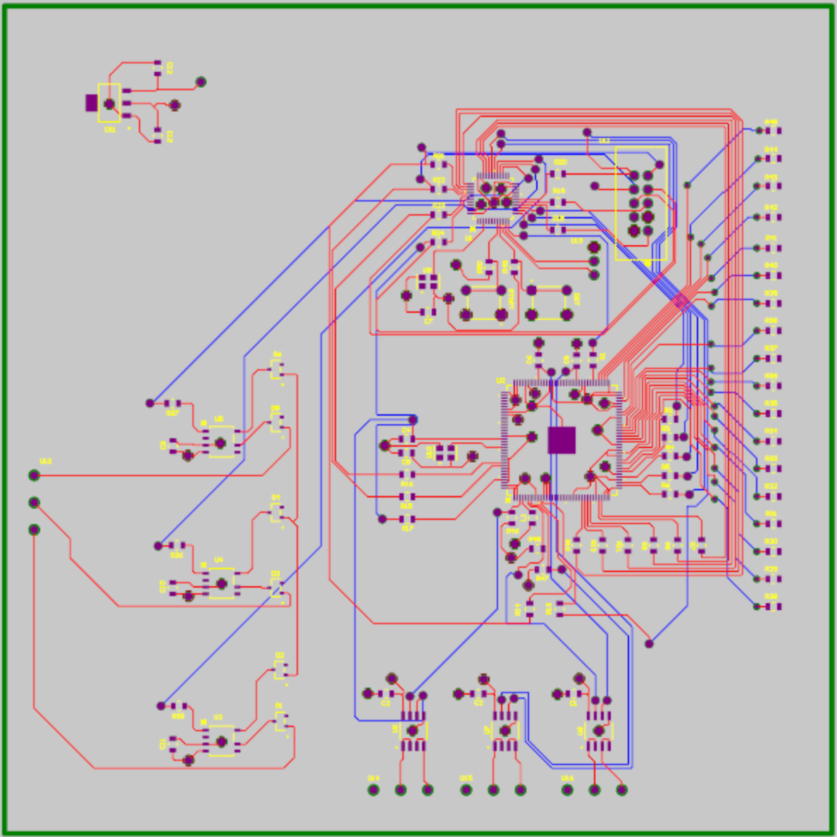
Pulse Generator Subsystem
Daniel Loeza
Old PCB

Slide 12
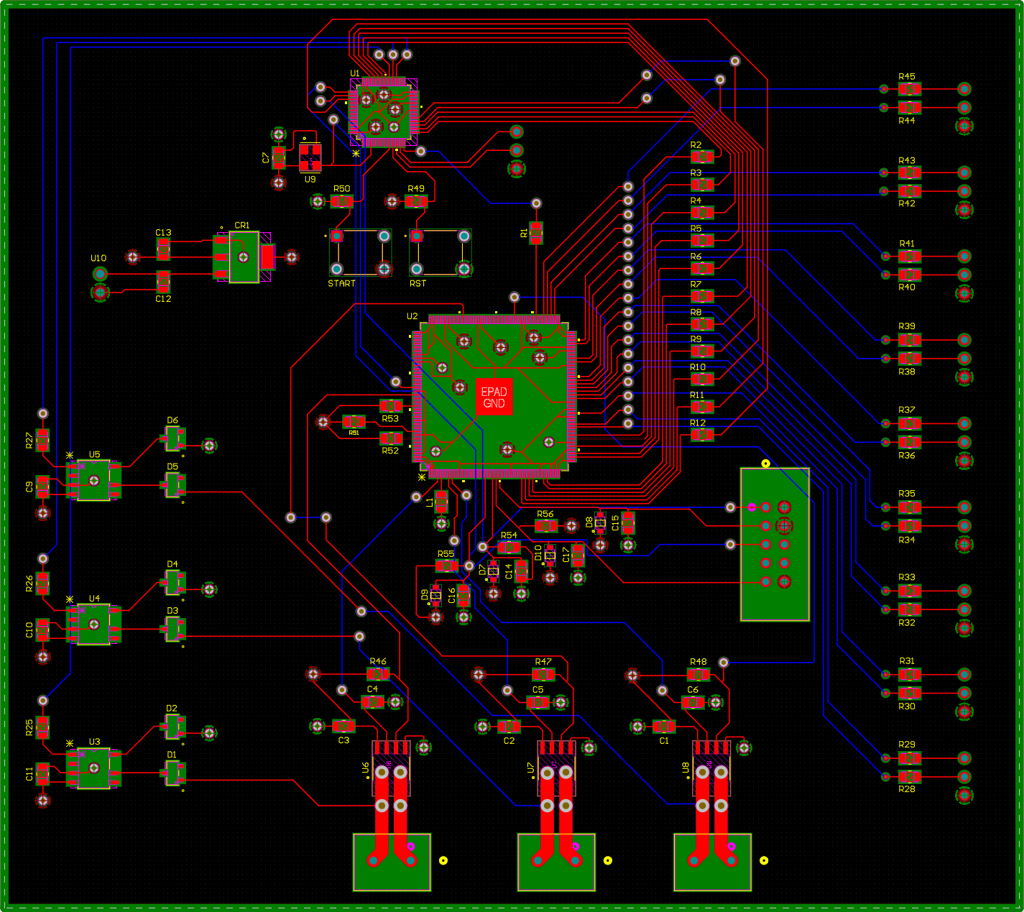
Pulse Generator Subsystem
Daniel Loeza
New PCB

Slide 13
Parts Ordering Status
Part | Expected Date
Redesigned Pulse Generator PCB | Order should be placed no later than 9/2
New Pulse Generator Components | Order should be placed no later than 9/2
(9)x Bidirectional Switch PCB | Order should be placed no later than 9/16
Bidirectional Switch Components | Order should be placed no later than 9/16
Notes:
Someone else do this one

Slide 14
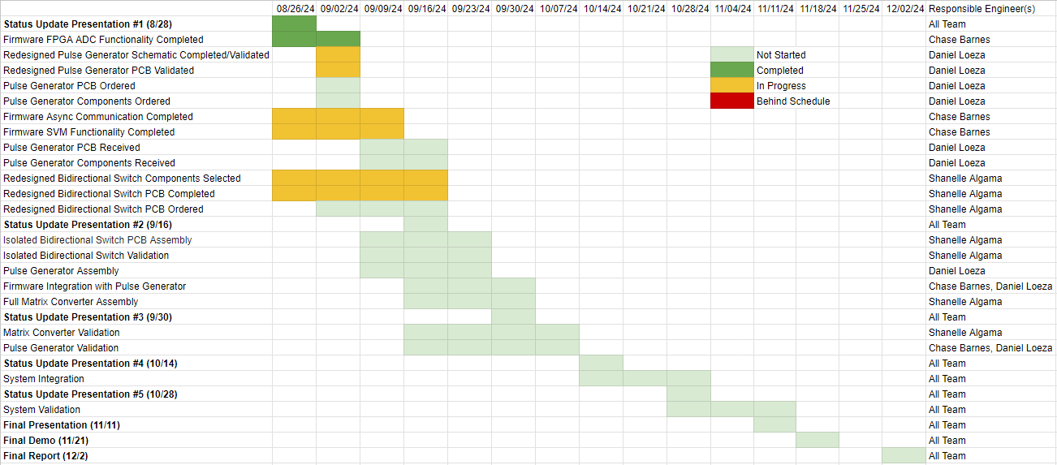
Execution & Plan

Slide 15
Thanks, and Gig ‘em!

